Slide 1
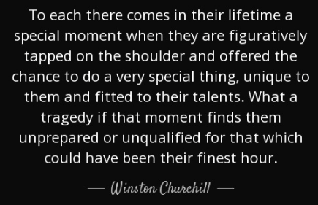

2024-25 New AD Orientation
August 1, 2024
Notes:
CD

Slide 2
Presenters
NHADA Executive Director/NIAAA Liaison Carol Dozibrin, CMAA
NHADA President Sarah Dumais, CAA
NHADA President-Elect Chris Wood, CAA
NHADA Treasurer/Membership Chair Lisa Gingras, CMAA
NHADA Outreach Co-Chairs Mike Desilets, CMAA
Rodney Brown, CMAA
Notes:
CD

Slide 3
New Athletic Administrators 2024-25
Campbell | Tony Ramos
Concord | Steve Largy
ConVal | Larry Pimental
Dover | Joshua Knight
Exeter | Cathy Clermont
Goffstown | Ryan Cowette
Holy Family Academy | Rodney Sanders
Kearsarge | Taylor Lipinski
Kingswood | Vaughn Beckwith
Lebanon | Ben Davis
Mount Royal Academy
Spaulding
Pelham | Justin Hufft
Pittsburg-Canaan | Josiah Riley
Profile | Dylan Robie
Prospect Mountain | James Christie
Wilton-Lyndeborough | Amber Brewster
Winnisquam | Ian Snowdeal
Hanover Asst. | Denver Greene
Kearsarge Asst. | Molly McDougal
Kingswood Asst. | Kyle Diamond
Nashua North Coordinator | Mike Soucy
Souhegan Asst. | Ben Arnold
Notes:
CD

Slide 4
Agenda
Foundations
NHADA Resources
NIAAA Resources
Relationships
Communication
Time Management
Operations
Budget
Organization
Event Management (including crowds)
After School Safety
Leadership
Culture
14 Legal Duties
Professional Development
Coaches’ Meetings
Personnel (hire, evaluate, retain, dismiss)
Notes:
CD

Slide 5

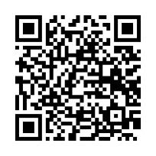
Foundations - NHADA Resources
NHADA Website
Mentor Program
FinalForms for Associations
Membership
New AD Handbook 2024-25
NHADA Apps:
HS: App Store NHADA
PW: nhADa!
Middle School:
SportsYou
Notes:
CD

Slide 6
Foundations - NIAAA Resources
NIAAA Website
New Athletic Director Packet
Profile of an Athletic Administrator
Athletic Administrator Job Description & Evaluation
Professional Development Academy Handbook
Leadership Training Institute Course Descriptions
Notes:
LG

Slide 7
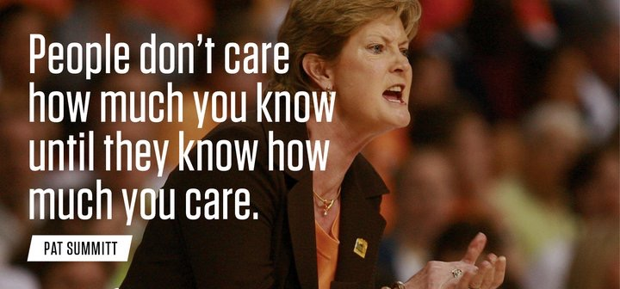
Foundations - Relationships
NHADA, NHIAA, NIAAA, NFHS
Students
Parents
School Staff
Athletic Department Staff
Coaches
Bus Company
Business Office
Community
Notes:
LG and SD

Slide 8






Foundations - Communication
Mass Emails- IC, Alma, school information system
Communication Apps
Media- utilize newspapers
Social Media
Notes:
MD
LTC 709

Slide 9
Foundations - Time Management
168 hours
Daily tasks
Leadership tasks
Self
Family
Notes:
LG

Slide 10
Time for Discussion and Questions
Foundations
NHADA Resources
NIAAA Resources
Relationships
Communication
Time Management
Notes:
CD

Slide 11
Break
Notes:
CD

Slide 12
Leadership - Culture
Manager vs Leader
Mission, Vision, Values ~ Explain your why
Provide direction ~ Walk the talk
Support/Grow your team
Listen
Build Community
Reflect and learn
Notes:
RB
LTC 727

Slide 13
Leadership - 14 Legal Duties
Plan
Supervise
Select & Train Coaches
Appropriate Instruction
Warn
Safe Environment
Protective Equipment
Readiness for Practice/Competition
Evaluate Injury
Match/Equate Athletes
Emergency Care
Emergency Response Plan
Safe Transportation
Sports-Related Disclosures
Notes:
LG
LTI 504, 506, 508, 510

Slide 14
Leadership - Professional Development
Coaches
Coaches’ Meetings
Book Studies
Self
Other Staff
Notes:
SD and CW

Slide 15
Leadership - Personnel
Recruit
Hire
Develop
Evaluate
Retain
Dismiss
Notes:
CD and LG
You are empowered to lead in many ways…..
● Provide a direction for the entire department
● Provide an identity
● Hire coaches who are leaders
● Provide professional development opportunities
● Develop people
LTC 704

Slide 16
Time for Discussion and Questions
Leadership
Culture
14 Legal Duties
Professional Development
Coaches’ Meetings
Personnel (hire, evaluate, retain, dismiss)
Notes:
CD

Slide 17
Operations - Budget
Year 1
Needs vsWants
Who gets to have input?
Revenue sources
Operating budget vs other funds
Fundraising
Notes:
RB
Emphasize 502
LTC 511

Slide 18
Operations - Organization
Timeline and deadlines
Event schedules
Time off
Calendars and apps
Checklists
Notes:
SD and CW
Emphasize 502

Slide 19
Operations - Event Management
Planning- holiday tourney, NHIAA event, e-tickets, personnel
Executing- make a plan and go for it, maintain flexibility
Reflecting- what should we have done differently
Teams, coaches, officials, fans- Admin from other schools available?
Look at other facilities to see how they would do it
Notes:
MD & RB
Handbook starting on page 13
Emphasize 502
LTC 625, 630, 631

Slide 20
Operations - After School Safety
Emergency Action Plans
Athletic Emergency Action Plan-A Template for Successful Implementation
Event Management Best Practices
Notes:
CD
Emphasize 502
LTC 625, 630, 631

Slide 21

Goals
Discuss one goal you have before school starts and the action items needed to achieve that goal.
Discuss one goal you have for this year and how you plan to achieve it.
What do you need to continue on a successful path?
Notes:
Everybody

Slide 22
Thank You
Feel free to reach out for more information or clarification.
We will stay to answer any other questions/concerns.
NHADA Executive Director - Carol Dozibrin, CMAA nhathdirassoc@gmail.com
NHADA President – Sarah Dumais, CAA sarah.dumais@interlakes.org
NHADA President-Elect – Chris Wood, CAA cwood@sau45.org
NHADA Treasurer/Membership – Lisa Gingras, CMAA gingrasl@nashua.edu
NHADA Outreach Co-Chairs – Mike Desilets, CMAA mdesilets@bownet.org
Rodney Brown, CMAA rodney.brown@sau24.org

