Slide 1
Booster Groups
The Timberlane Model
Presented by: Mr. Angelo Fantasia, CMAA.

Slide 2
Question
Do you have a current booster program?

Slide 3
The Council for Timberlane Athletics
About Us:
Established to help integrate interscholastic athletics with the total educational program of the school district.
Serves as a liaison between the Athletic Department, booster groups, coaches, and athletes.
Advises in matters relating to finances, athletic projects, and athletic policy.

Slide 4
The Council Philosophy
Provide
Provide equal representation for all interscholastic teams.
Promote
Promote a positive image of Timberlane Athletics
Recommend and suggest
Recommend and suggest policy to the Administration
Help
Help provide fiscal aid to various athletic programs
Help
Help organize, maintain, and create any projects or events that would be beneficial to Timberlane Students.

Slide 5
Group Structure
The Council in conjunction with the Athletic Director, oversees the responsibilities of all booster groups and their activities.
Nearly every sport is accompanied by a coinciding booster group.
Individual booster groups are responsible for electing new officials on a yearly basis.
Positions include:
President, Vice President, Treasurer, and Secretary
It is the responsibility of the coach and booster president to frequently communicate.
Decisions are not made without the approval of the coach and coinciding booster group members, which is then brought to the Athletic Director for final approval.

Slide 6
Question
What is your current booster group structure?
One Overarching Group
Individual Team Boosters

Slide 7
Booster Group Responsibilities
Group Support
Provide additional communications to parents and community and maintain the team’s social media accounts
Financials
Raise funds for items that the athletic department does not provide.
Examples: Banquets, Scholarships, Bus Upgrades, Practice Jerseys, Trophies, Gifts, Apparel

Slide 8
Fundraising Guidelines
Fundraising activities may begin as follows:
Fall: July 1 Winter: November 1 Spring: March 1
The Athletic Fundraising Activity Request Form must be completed and signed by the coach. Once completed, the form is submitted to the Athletic Director for final approval. Fundraising may not begin until the form has been fully completed and sent back to the originator.
Fundraising may continue through to the end of the season unless otherwise approved by the Athletic Director. Please note that the preseason window is optional and whenever possible to avoid overlap with other sport/Booster Club fundraising activities.
1. The summer months provide an additional free window for certain fundraising activities (i.e summer camps, summer clinics, etc.). The Athletic Director should approve advance scheduling of these summer activities.
2. In season fundraising may also cover entry fees for summer program activities.

Slide 9
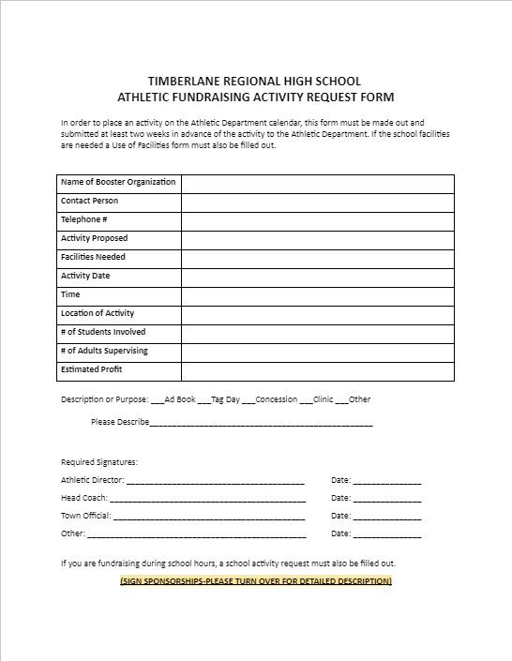
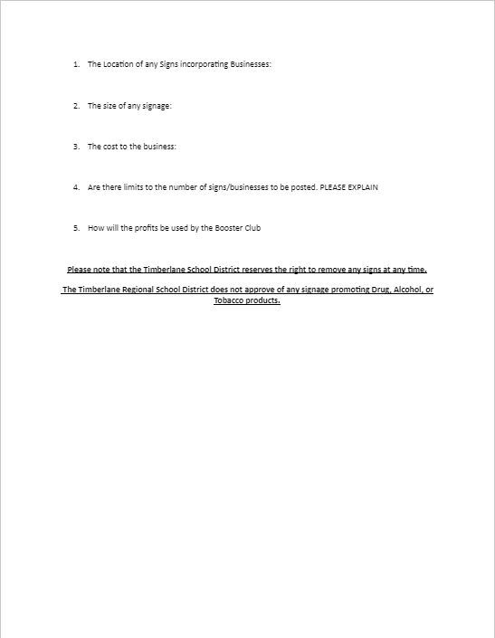
Timberlane Fundraising Form

Slide 10
Tax Responsibilities
Provide relevant tax documents to the Council to file yearly taxes.
Required Documents:
Yearly Trial Balance
December Bank Statement
January Bank Statement (after December 31 of the preceding month)
Previous year’s PAID scholarship information: recipient, amount, address
Contribute to the cost of tax prep and next year’s insurance coverage.
Example: This year, our booster groups were responsible for submitting a check for $300 each.

Slide 11
Question
Do you have standardized forms that your booster groups must submit? Ex. fundraising forms, equipment

Slide 12
Scholarship Guidelines
A Scholarship Agreement Form must be completed by the Head Coach and submitted to the Main Office.
The following criteria and guidelines should be utilized by all sports teams and their coinciding Booster Clubs.
If a student-athlete does not meet any of these requirements, they will not be eligible for final scholarship consideration.

Slide 13
Scholarship Guidelines (cont.)
1.
Candidates must complete the standard, school Scholarship Application Form and adhere to the designated deadline date.
3.
Candidates must be accepted to an accredited 2/4 Year College or University.
4.
The coaching staff may determine which candidates receive scholarships, or candidates can be forwarded to the Scholarship Committee for selection.
2.
Candidates must have been in the specific sport program for a minimum of 3 years. Must be a member of the program in their Senior Year.
7.
Coaches with extenuating circumstances may appeal to the Athletic Director for consideration.
5.
The individual program may allocate between $250.00-$2500.00 towards Scholarships in any given year. The coaching staff will set the amount based on funding and merit.
6.
Recipients must attend college in the fall immediately following their June High School graduation, Monies will be paid in the second semester of their freshmen year.

Slide 14
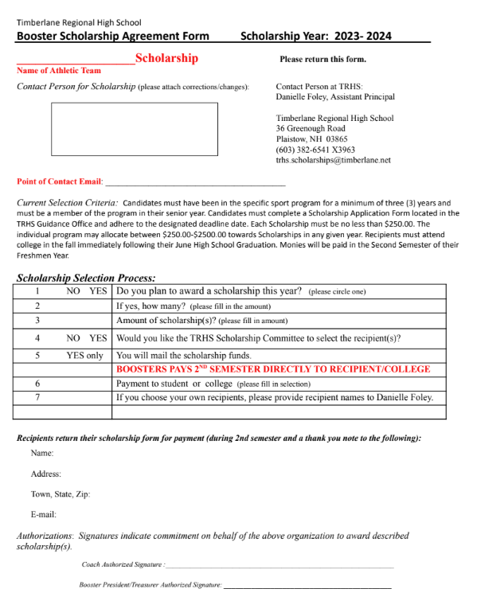
Timberlane Booster Scholarship Form

Slide 15
Question
What are some examples of allowable purchases from your booster groups? Ex. Do you allow boosters to pur

Slide 16
Final Thoughts…
Communication is the key
Create a paper trail
Protocols and procedures need to be followed

